Slide 1


Lecture one

Slide 2
Contents-Day 1
History of PHP.
Introduction to PHP
Why PHP?
What do we need? (LAMP Overview)
Installing LAMP
PHP Overview (Variables, Constants, Flow control, ….)

Slide 3
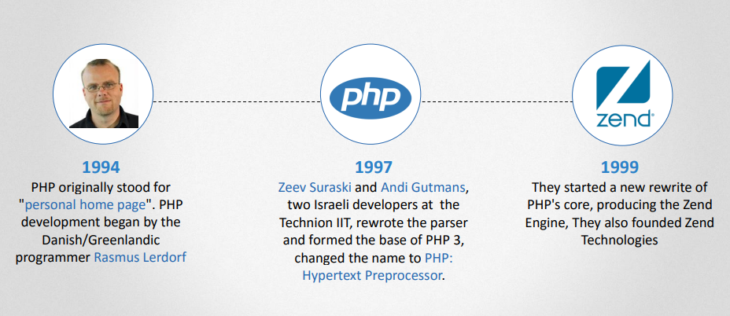
History

Slide 4
Introduction to PHP
Stands for: "Hypertext Preprocessor“
Server-side scripting language
executed on server then send the result as plain HTML
interpreted (not compiled)
Open source Any one can share and modify the source code
Compatible with almost all servers (Apache, Nginx, IIS …)
Supports wide range of databases (MySql, Sql Server, Oracle(
Portability run on any os
Availability of Support and Documentation
Most popular websites: Facebook, Yahoo, Wikipedia, Wordpress,.

Slide 5
Why PHP?
PHP can generate dynamic page content
PHP can create, open, read, write, delete, and close files on the server
PHP can collect form data
PHP can send and receive cookies
PHP can add, delete, modify data in your database
PHP can be used to control user-access
PHP can encrypt data

Slide 6





WHAT DO WE NEED?

Slide 7
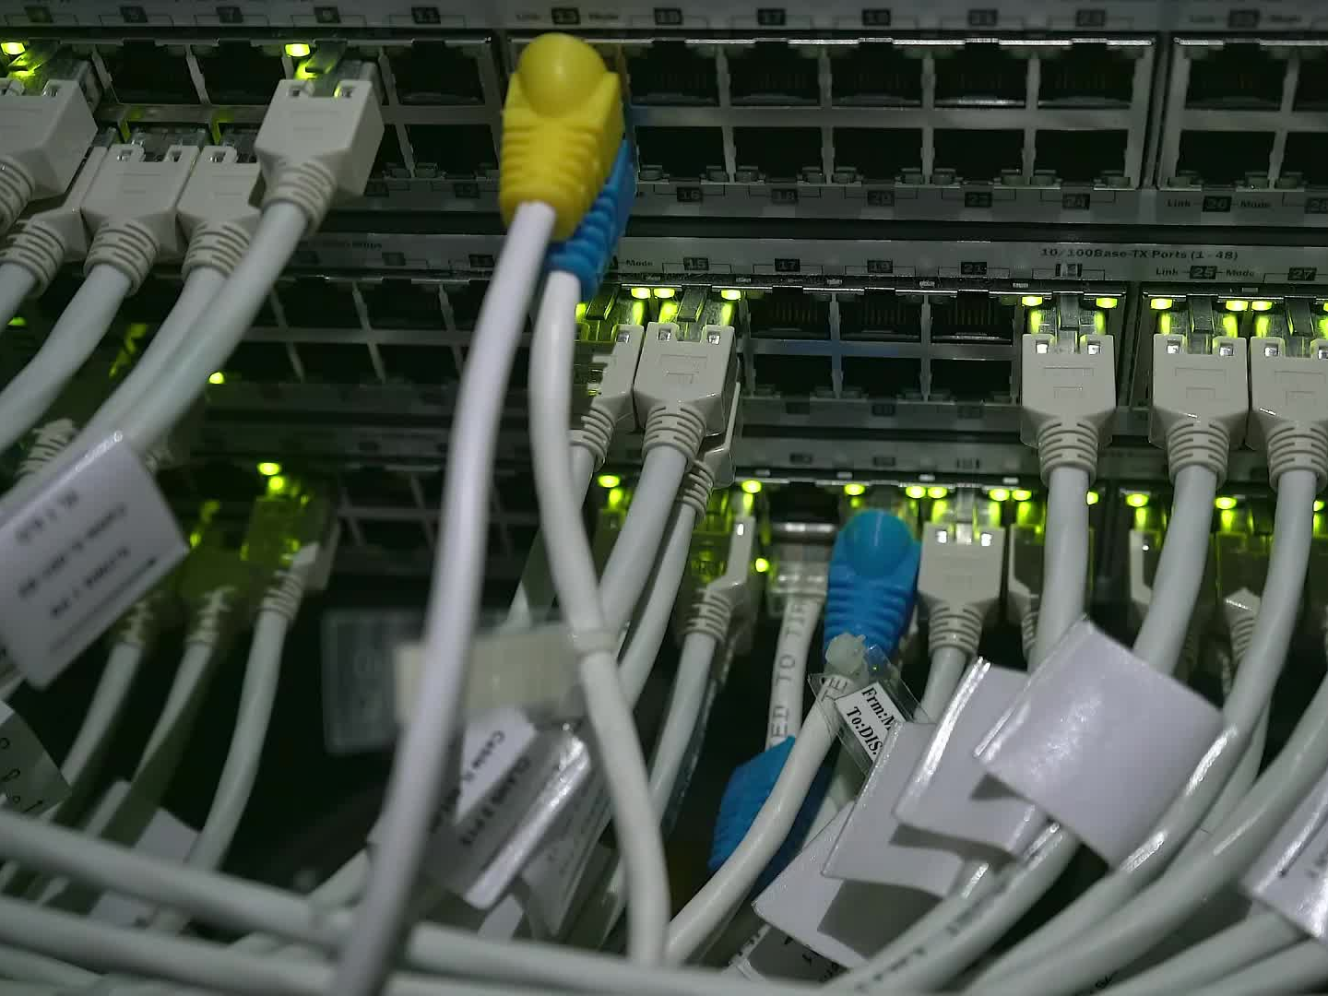
Installation
Ubuntu:
$ sudo tasksel install lamp-server
CentOS:
$ sudo yum install httpd mariadb-server mariadb php php-mysql

Slide 8
PHP files
Extension “.php”
Written between tags <?php your code here ?>
can contain text, HTML, CSS, JavaScript, and PHP code, Comments
PHP code is executed on the server, and the result is returned to the browser as plain HTML
Put your projects inside xampp/htdocs folder
You can write comments inside your php tags

Slide 9
PHP TAGS
XML style
<?php echo ‘<p>Hello!.</p>’; ?>
Short style
<? echo ‘<p>Hello!</p>’; ?>
SCRIPT style
<script language=’php’> echo ‘<p>Hello!.</p>’; </script>
ASP style
<% echo ‘<p>Hello!.</p>’; %>

Slide 10
Variables
Containers for storing information
Always starts with $
Case sensitive
Alpha-numeric and _ only (don’t start with a number)
Types: integer, float, string, boolean, array, object
Loosely typed language
Echo a variable (single quotes vs double quotes)
gettype()

Slide 11
Numbers
is_integer($var)
is_float($var)
is_double($var)
is_numeric($var)
Arithmetic expressions:
+ - * / % **
Right side assigned to left side

Slide 12
Strings
A sequence of characters
Use single or double qu
Concatenation using .
strlen($str);
str_word_count($str);
strpos($str, 'pattern');
str_replace('old pattern', 'new pattern', $str);
trim($str);
htmlspecialchars($str);

Slide 13
Super Global Variables $GLOBALS
$_COOKIE
$_SESSION
$_GET
$_POST
$_REQUEST
$_FILES
$_SERVER
$_ENV

Slide 14
If conditions
If … else if … else
Comparison opertors
Logical operators
Ex: max length validator
Ex: data type validator
Ex: grades

Slide 15
Loops
For
While
Do while
Break and continue
Foreach (will be explained later)
Ex: echo 1-100 except numbers dividable by 5 (for loop)
Ex: echo numbers until you reach 50 (while loop)
Ex: display a dynamic ul

